Slide 1

LECTURE 1: Introduction
Lecture time: 1 hr. 20 min.
Instructor: Maria Striki
Rutgers University
Ivan Marsic
Rutgers University

Slide 2
Course Information
Web: http://www.ece.rutgers.edu/~marsic/Teaching/SE
Lecture Notes:
http://www.ece.rutgers.edu/~marsic/books/SE
Textbooks
  Ian Sommerville: Software Engineering, Pearson 10th edition.
  Bruegge & Dutoit: Object-Oriented Software Engineering: Using UML, Patterns and Java, Third Edition, Prentice Hall, 2010. | ISBN 0-13-6061257
  Miles & Hamilton: Learning UML 2.0, O’Reilly Media, 2006. ISBN: 0-596-00982-8

Slide 3
Team Projects
Form teams of 5 (± 1?) students
DEADLINE: Friday, September 16, 2016
After that, teams assigned randomly
Project Ideas:
http://www.ece.rutgers.edu/~marsic/books/SE/projects
No more than six (6) groups working on the same project, First Come First Served Policy
DEADLINE: Tue, September 20, 2016
After that, teams assigned randomly one project
Project Ideas:
Two (2) new projects allowed – email your project idea ASAP, before proposal is due (for feedback).

Slide 4
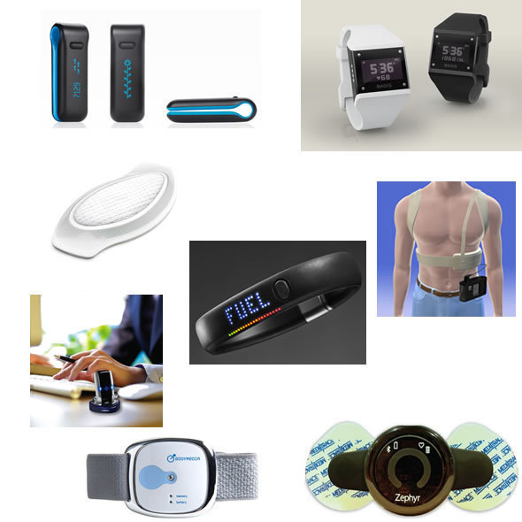
Personal Health Monitoring Devices
Available budget:
$500
To do:
1. Search the Web
for devices and apps
that you would like to
work with
2. Email the components
list with costs+websites
Notes:
http://www.informationweek.com/healthcare/mobile-wireless/health-monitoring-devices-market-outpace/240001352
http://www.informationweek.com/healthcare/mobile-wireless/10-wearable-devices-to-keep-patients-hea/240000353
http://www.informationweek.com/healthcare/mobile-wireless/forget-google-glasses-meet-wearable-heal/232900190
http://www.wired.co.uk/magazine/archive/2012/03/test/track-your-body-data/viewgallery

Slide 5
Project Deliverables
Item |  | Due date
I t e r a t. #1 | 1. Proposal | Sep 20
 | 2. First report (Specification only) • Part 1 (Statement of Work & Requirements) • Part 2 (Functional Requirements Spec & UI) • Full Report #1 | Sep 26 Sep 30 Oct 04
 | 3. Second report (Design only) • Part 1 (Interaction Diagrams) • Part 2 (Class Diagram and System Architecture) • Full Report #2 | Oct 14 Oct 21 Oct 28
 | 4. First demo | Nov 4-11 ► ...
I t e r #2 | 5. Third report (All reports collated) | Nov 26
 | 6. Second demo | Dec 2 ► ...
 | 7. Electronic Project Archive | Dec 2

Slide 6
Syllabus (1)
Instructor: Maria Striki
Email: maria.striki@rutgers.edu
Office: CORE 516
Where/When?
Lecture: Fri 18.40 – 21.40, SEC 205
Office Hours Instructor (tentative):
TBA, CORE 516
Also by appointment (Tue-Wed-Thu-Fri).

Slide 7
Syllabus (2)
Student Assignments:
On-going SE Project done in groups (the formulation of the groups to be discussed in class).
For each deliverable, your deliverable is graded by 5 more teams (at least).
Almost weekly in-class quizzes.
A few take-home quizzes or HW
One exam (midterm).
No final – project demos and presentations

Slide 8
Syllabus (3)
Grading Policy:
  Exam: roughly 20% (TBD)
  Projects: roughly 60% (TBD)
  Quizzes/Grading/Class Participation: roughly 20% (TBD)
Extra Experience-Exposure:
Lectures from experts or specific SE topics (TBD)
Lectures from individuals working in industry, involved with large, well-known agencies and institutes. Directions, insights, current trends.

Slide 9
Introduction: Software is Complex
Complex ≠ complicated
Complex = composed of many simple parts
related to one another
Complicated = not well understood, or explained

Slide 10
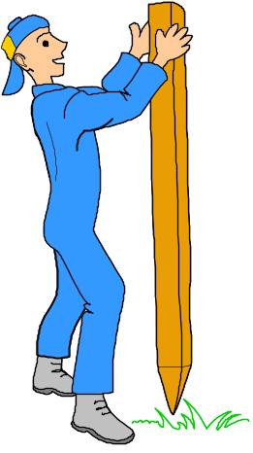
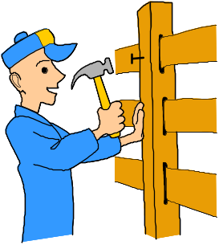
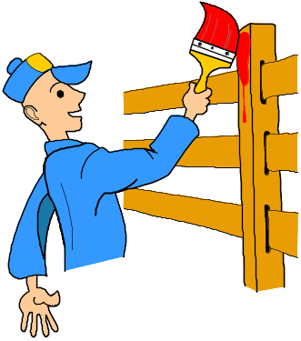
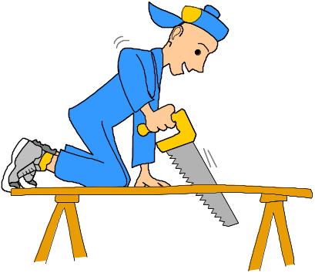
Complexity Example:
Scheduling Fence Construction Tasks
Setting posts
[ 3 time units ]
Cutting wood
[ 2 time units ]
Nailing
[ 2 time units for unpainted;
3 time units otherwise ]
Painting
[ 5 time units for uncut wood;
4 time units otherwise ]
Setting posts < Nailing, Painting
Cutting < Nailing
…shortest possible completion time = ?
[ ⇒ “simple” problem, but hard to solve without a pen and paper ]
Notes:
SOURCE: Goodaire & Parmenter, Discrete Mathematics with Graph Theory, Third Edition, Pearson Prentice Hall, 2006. [ Section 11.5, p. 361 ]

Slide 11

More Complexity
Suppose today is Tuesday, November 29
What day will be on January 3?
[ To answer, we need to bring the day names and the day numbers into coordination, and for that we may need again a pen and paper ]
Notes:
SOURCE: Hutchins, Cognition in the Wild, The MIT Press, 1995. [ p. 315 ]

Slide 12

The Role of Software Engg. (1)
A bridge from customer needs to programming implementation
Customer
Software Engineering
Programmer
First law of software engineering
Software engineer is willing to learn the problem domain
(problem cannot be solved without understanding it first)
Notes:
"You cannot solve it, unless you understand it."

Slide 13
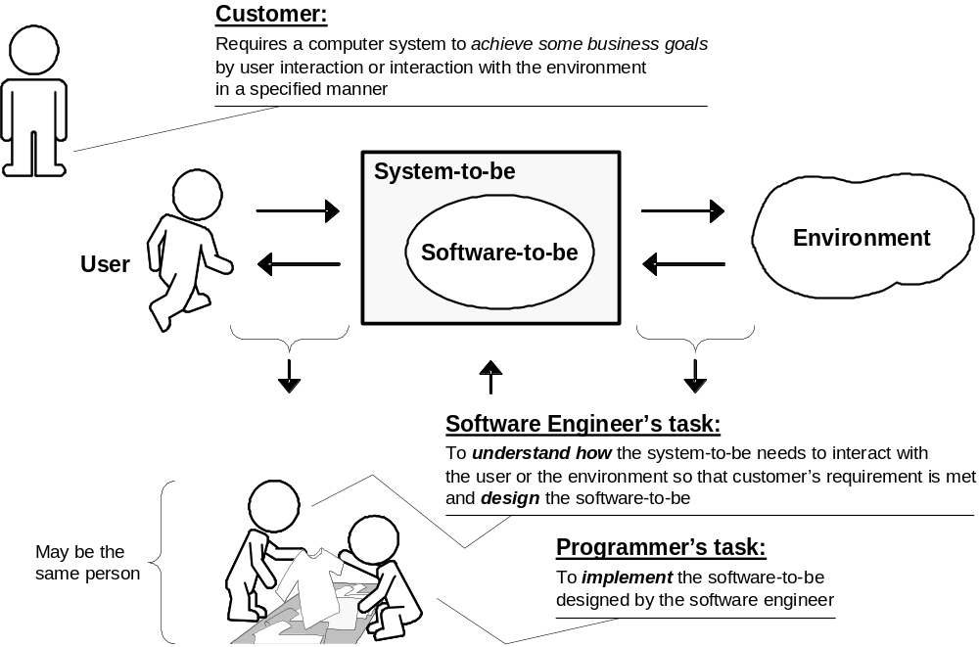
The Role of Software Engg. (2)

Slide 14
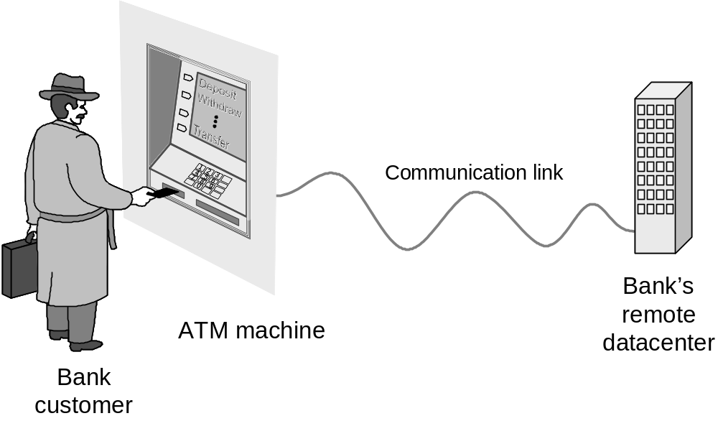
Example: ATM Machine
Understanding the money-machine problem:

Slide 15
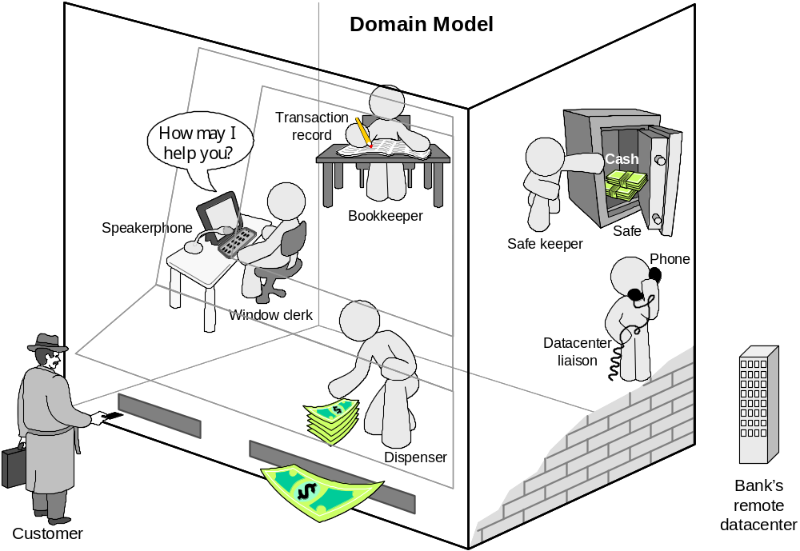
How ATM Machine Might Work
Domain model created with help of domain expert

Slide 16
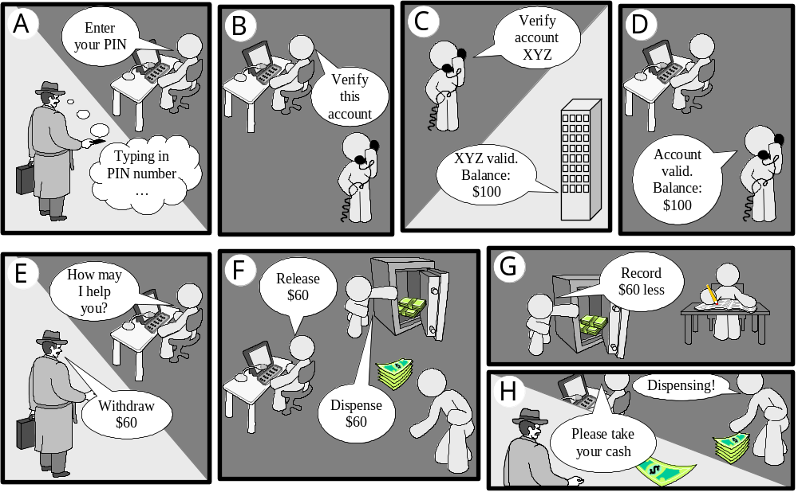
Cartoon Strip: How ATM Machine Works

Slide 17
Software Engineering Blueprints
Specifying software problems and solutions is like cartoon strip writing
Unfortunately, most of us are not artists, so we will use something less exciting:
UML symbols
However …

Slide 18
Second Law of Software Engineering
Software should be written for people first
  ( Computers run software, but hardware quickly becomes outdated )
  Useful + good software lives long
  To nurture software, people must be able to understand it

Slide 19
Software Development Methods
Method = work strategy
    The Feynman Problem-Solving Algorithm:
    (i) Write down the problem (ii) think very hard, and (iii) write down the answer.
Waterfall
    Unidirectional, finish this step before moving to the next
Iterative + Incremental
    Develop increment of functionality, repeat in a feedback loop
Agile
    User feedback essential; feedback loops on several levels of granularity

Slide 20
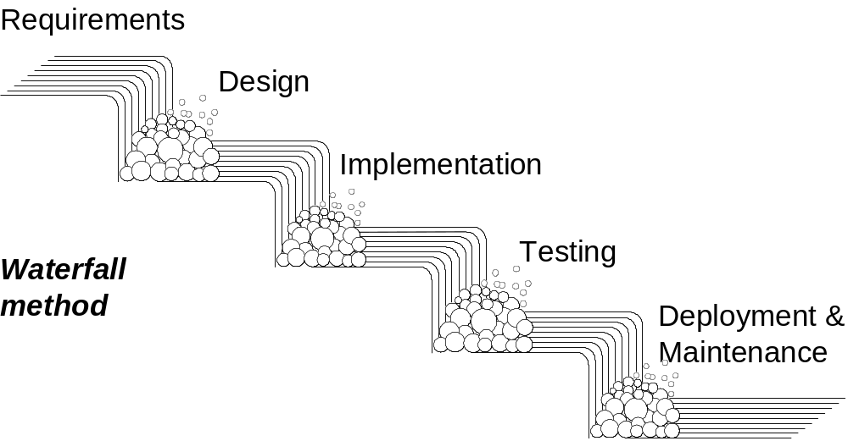
Waterfall Method
Unidirectional, no way back
finish this step before moving to the next

Slide 21
Agile Method
Why Agile: Agile follows an incremental approach and came about as a “solution” to the cons of the waterfall methodology.
Developers start off with simplistic project design, and then begin to work on small modules, in weekly or monthly sprints. At the end of each sprint, project priorities are evaluated and tests are run. These sprints allow for bugs to be discovered, and customer feedback to be incorporated into the design before the next sprint is run.
The process, with its lack of initial design and steps, is often criticized for its collaborative nature that focuses on principles rather than process.
Differences: the approach to quality and testing.
Watefall: there’s always a separate testing phase after a build phase;
Agile: development testing is completed in the same iteration as programming.
Because testing is done in every iteration—which develops a small piece of the software—users can frequently use those new pieces of software for validation.

Slide 22
Open-sourcing Method (1)
Generic products
  The specification of what the software should do is owned by the software developer and decisions on software change are made by the developer.
Customized products
  The specification of what the software should do is owned by the customer for the software and they make decisions on software changes that are required.
And then …. comes Open-Sourcing (from 1998)
  Open-source software (OSS) is computer software with its source code made available with a license in which the copyright holder provides the rights to study, change, and distribute the software to anyone and for any purpose. Open-source software may be developed in a collaborative public manner. Open-source software is the most prominent example of open-source development.

Slide 23
Open-sourcing Method (2)
Examples
  Netscape, GNU project, Mozilla, ....
Advantages
  Everyone contributes towards maximum incremental progress, maximum performance, maximum usability, maximum re-use. Open-sourcing encapsulates the essence of optimal collaboration and one sense (and up to a point) optimal Software Engineering. Plus your products gains the maximum popularity and you … gain the maximum benefit!
  In particular:
  Easier to obtain – higher usage, availability increases adoption.
  Lower costs of marketing and logistical services
  More flexible technology – quicker innovation
  Better security because software adheres to technology and not commercial/customers requirements

Slide 24
Open-sourcing Method (3)
Disadvantages
  Often, contributions-updates-increments (particularly in Software) may go without extensive testing and they may contain bugs.
  There can be disagreement as to the direction an extensive project is taking.
  The nature of many companies, projects, and products around the world is more private, more rigorous, sometimes classified, and would not allow for open-sourcing directions.
  More prone to hackers
Thank you Shreash Rao for your very important Contribution!

Slide 25
Waterfall vs. Agile
Traditional project management styles, like Waterfall, build in phases. This style of product development folds everything into a single, "big bang", high-risk release. Once a project passes one phase, it's painful to revisit it because teams are always pressing forward to the next stage.
Both methodologies have strengths and weaknesses. The key to deciding which is right for you comes down to the context of the project.
Is it going to be changing rapidly? Select Agile.
Do you know exactly what you need? Select Waterfall
When to use Watefall
1. When there is a clear picture of what the final product should be.
2. When clients won’t have the ability to change the scope of the project once it has begun.
3. When definition, not speed, is key to success.

Slide 26
Waterfall Pros
Watefall stresses meticulous record keeping. Having such records allows for the ability to improve upon the existing program in the future.
2. With Watefall, the client knows what to expect. They’ll have an idea of the size, cost, and timeline for the project. They’ll have a definite idea of what their program will do in the end.
3. In the case of employee turnover, Waterfall’s strong documentation allows for minimal project impact.

Slide 27
Waterfall Cons
Once a step is complete, developers can’t go back to a previous one and change it.
2. Waterfall relies heavily on initial requirements. If these requirements are faulty, the project is doomed. If a requirement error is found, or a change needs to be made, the project has to start from the beginning with all new code.
3. The product is only tested at the end. If bugs are written early, but discovered late, their existence may have affected how other code was written. The temptation to delay thorough testing is often very high, to allow for short-term wins of staying on-schedule.
4. The plan doesn’t take into account a client’s evolving needs. What if the client realizes they need more than they initially thought, and demands change?

Slide 28
Agile Pros
1. Agile allows for changes to be made after initial planning. Re-writes to the the program, as the client decides to make changes, are expected.
2. Because Agile allows you to make changes, it’s easier to add features that keep you up to date with latest developments in your industry.
3. At the end of each sprint, project priorities are evaluated. This allows clients to add their feedback so that they ultimately get the product they desire.
4. The testing at the end of each sprint ensures that the bugs are caught and taken care of in the development cycle. They won’t be found at the end.
5. Because the products are tested so thoroughly with Agile, the product could be launched at the end of any cycle. As a result, it’s more likely to reach its launch date.

Slide 29
Agile Cons
With a less successful project manager, the project can become a series of code sprints. If this happens, the project is likely to come in late and over budget.
2. As the initial project doesn’t have a definitive plan, the final product can be grossly different than what was initially intended.

Slide 30
UML (1)
(Unified) Modeling language that captures the architectural, behavioral, structural aspects of a system.
Objects: they are the key to the OO design.
Process: Identify objects correctly, then assign responsibilities to them.
UML Diagrams: Use them to model and design. Structural and behavioral.
Structural Diagrams: consist of static diagrams, like class and object diagrams. Class diagrams represent the whole system and are the only diagrams to be directly mapped to OOLs. They consist of attributes and functions. Object Diagrams are instances of Class Diagrams. Other structural diagrams are: component diagrams, deployment diagrams.
Behavioral Diagrams: consist of dynamic diagrams, such as the use-case diagrams, sequence diagrams, collaboration diagrams, etc.

Slide 31
UML (2)
An object contains both data and methods that control the data.The data represents the state of the object.
A class describes an object and they also form hierarchy to model real world system.
The hierarchy is represented as inheritance and the classes can also be associated in different manners as per the requirement.
The objects are the real world entities that exist around us and the basic concepts like abstraction, encapsulation, inheritance, polymorphism all can be represented using UML.
So UML is powerful enough to represent all the concepts exists in object oriented analysis and design.
UML diagrams are representation of object oriented concepts only.

Slide 32
Fundamental Concepts of OOW
Objects: Objects represent an entity and the basic building block.
Class: Class is the blue print of an object.
Abstraction: Abstraction represents the behavior of an real world entity.
Encapsulation: Encapsulation is the mechanism of binding the data together and hiding
them from outside world.
Inheritance: Inheritance is the mechanism of making new classes from existing one.
Polymorphism: It defines the mechanism to exists in different forms.

Slide 33
Purpose of OO Analysis and Design
Identifying the objects of a system.
Identify their relationships.
Make a design which can be converted to executables using OO languages.
Three basic steps where OO concepts are applied/implemented:
OO Analysis -> OO Design -> OO Implementation w/ OO languages.
Analysis: Identifying the objects and responsibilities of a system correctly.
Design: emphasize on requirements and their fulfillment. Objects are collaborated according to their intended association.
Implementation: Implement the design using OOL such as Java, C++.

Slide 34
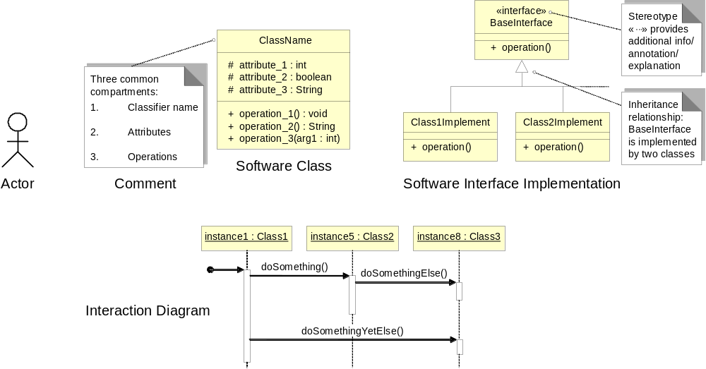
UML – Language of Symbols
UML = Unified Modeling Language
Online information:
http://www.uml.org

Slide 35
Understanding the Problem Domain
System to be developed
Actors
  Agents external to the system
Concepts/ Objects
  Agents working inside the system
Use Cases
  Scenarios for using the system

Slide 36
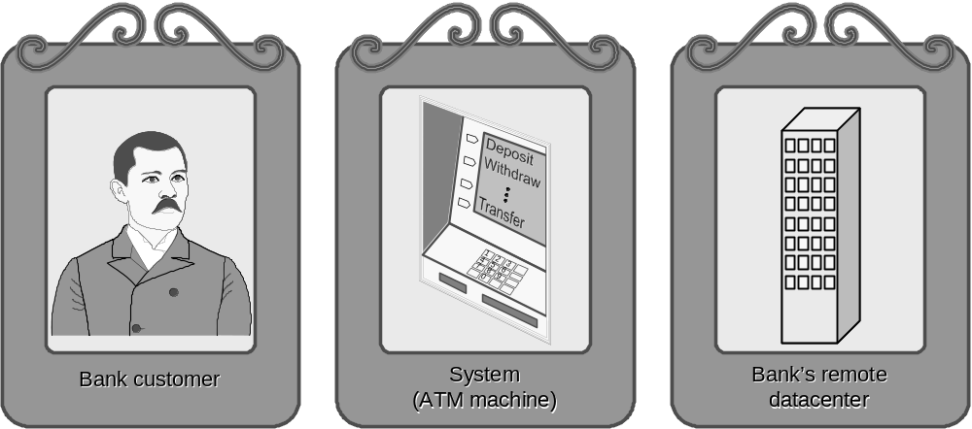
ATM: Gallery of Players
Actors
(Easy to identify because they are visible!)

Slide 37
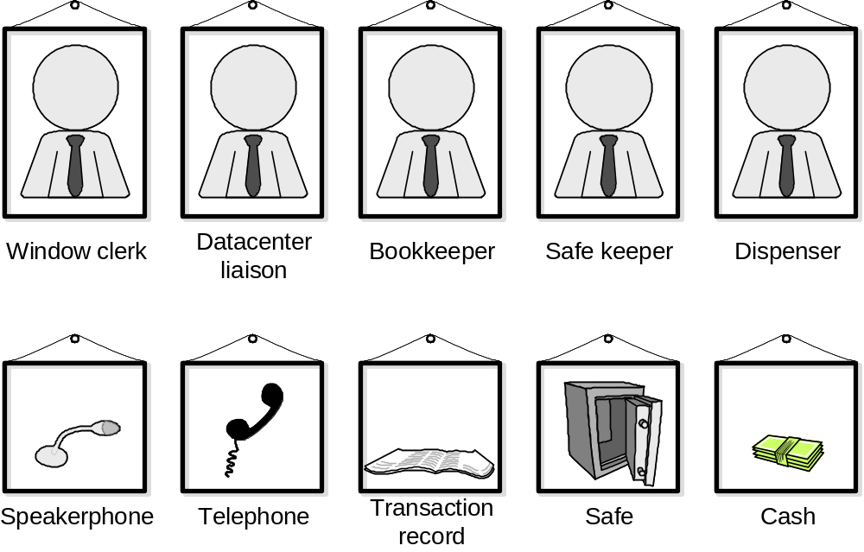
Gallery of Workers + Things
Concepts
(Hard to identify because they are invisible/imaginary!)

Slide 38
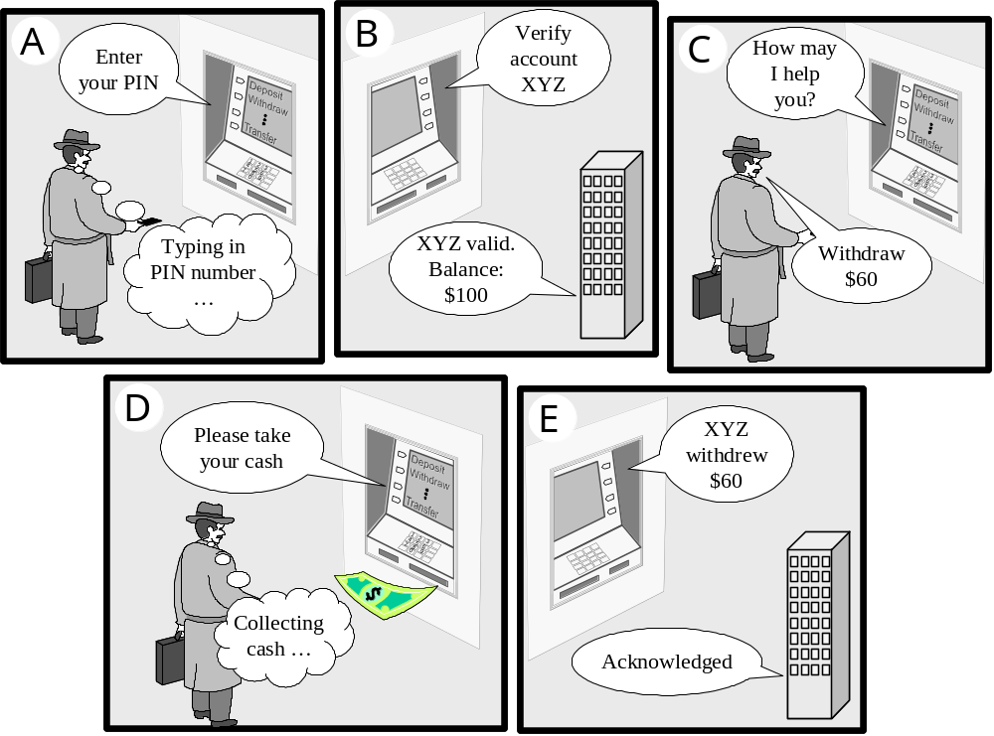
Use Case: Withdraw Cash

Slide 39
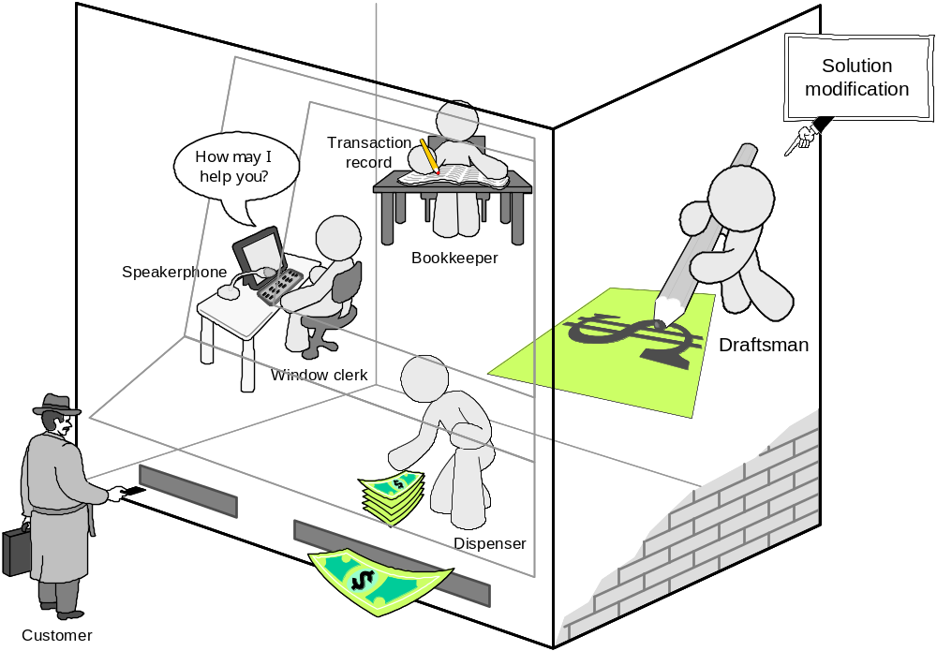
How ATM Machine Works (2)
Domain Model (2)
Alternative solution

Slide 40
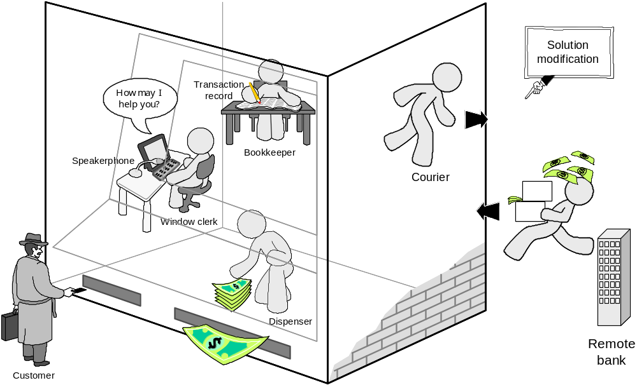
How ATM Machine Works (3)
Domain Model (3)
Alternative solution
Which solution is the best or even feasible?

Slide 41
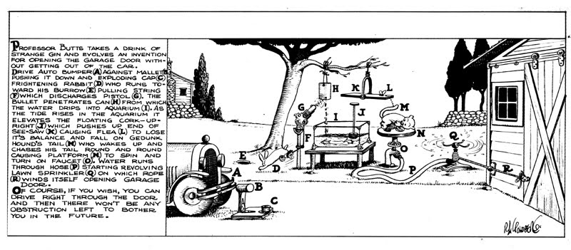
Rube Goldberg Design
Garage door opener

Slide 42
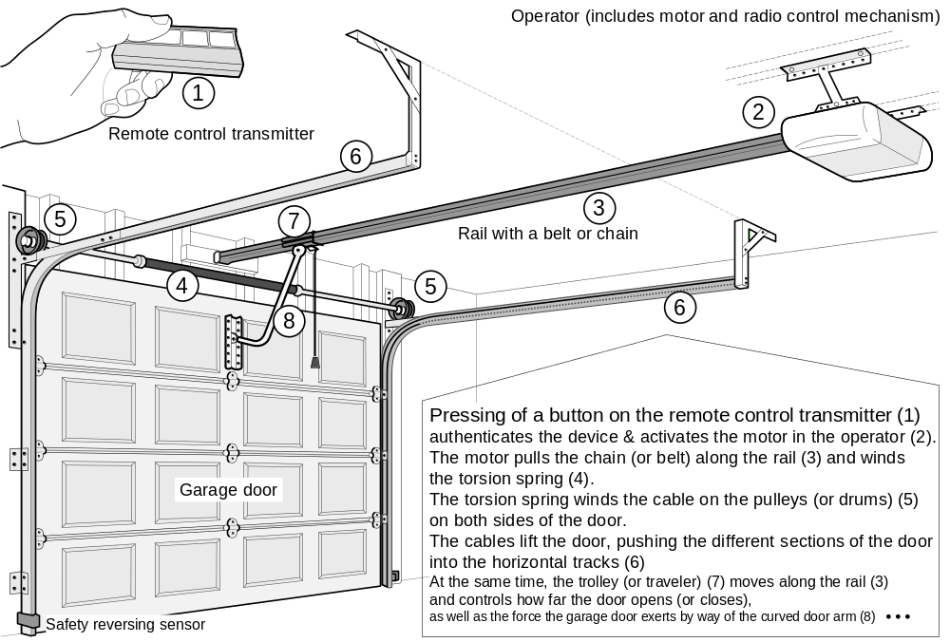
Actual Design

Slide 43
Cornerstone of Software Design
Design Quality Evaluation: compare different designs and decide
Design for change: sustainability by accounting for the ever-changing world and environment
Design for reuse: robustness-flexibility-economy

Slide 44
Software Measurement
What to measure?
  Project (developer’s work),
  for budgeting and scheduling
  Product,
  for quality assessment

Slide 45
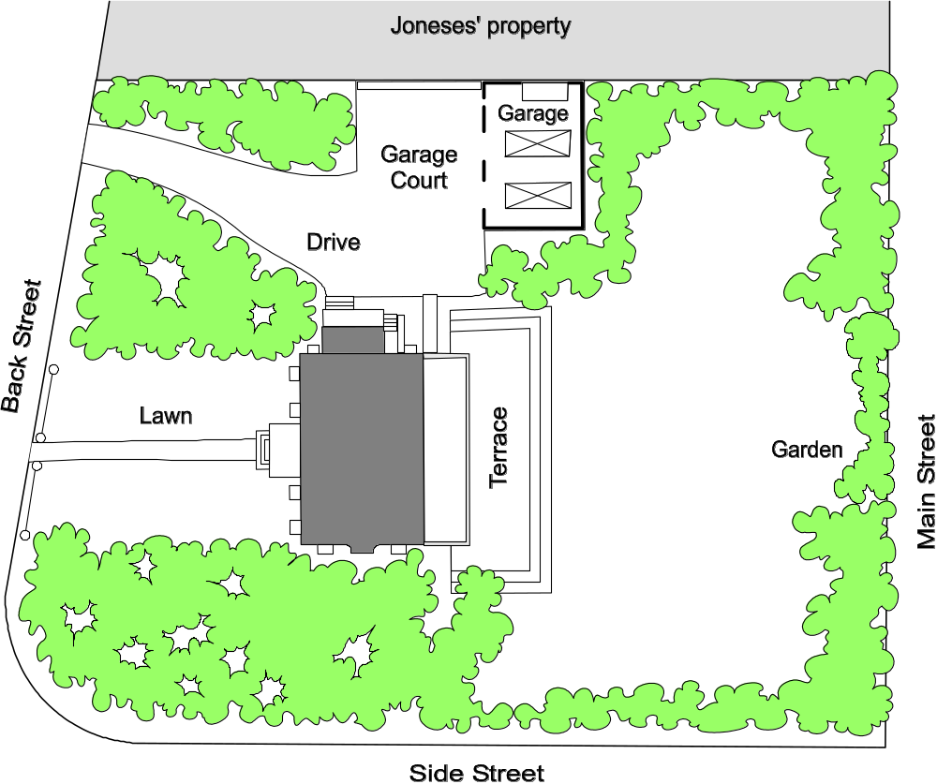
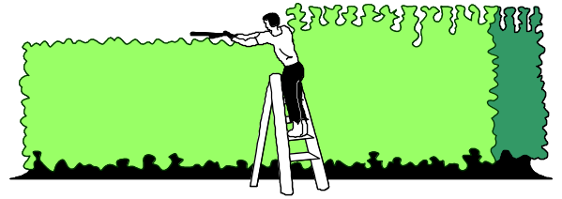
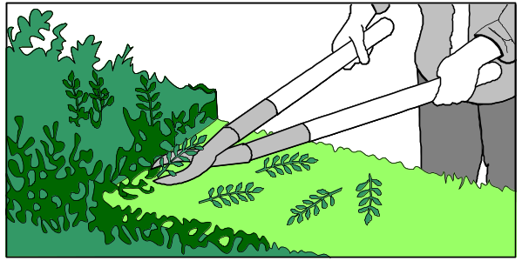
Formal hedge pruning

Slide 46
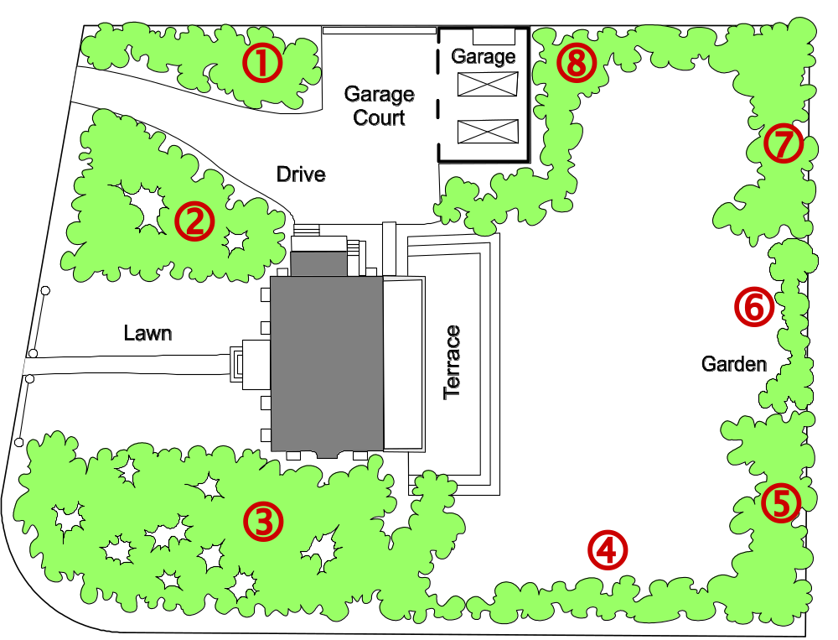
Sizing the Problem (1)
Step 1: Divide the problem into small & similar parts
Step 2:
Estimate relative sizes of all parts
Size(  ) = 4
Size(  ) = 7
Size(  ) = 10
Size(  ) = 3
Size(  ) = 4
Size( □ ) = 2
Size(  ) = 4
Size(  ) = 7

Slide 47
Sizing the Problem (2)
Step 3: Estimate the size of the total work
Total size = Σ points-for-section i (i = 1..N)
Step 4: Estimate speed of work (velocity)
Step 5: Estimate the work duration
Travel duration =
Path size
Travel velocity

Slide 48
Sizing the Problem (3)
Advantages:
  Velocity estimate may need to be adjusted (based on observed progress)
  However, the total duration can be computed quickly (provided that the relative size estimates of parts are accurate – easier to achieve if the parts are small and similar-size)

Slide 49
Exponential Cost of Estimation
100%
Estimation accuracy
Estimation cost
Improving accuracy of estimation beyond a certain point requires huge cost and effort (known as the law of diminishing returns)
In the beginning of the curve, a modest effort investment yields huge gains in accuracy

Slide 50
Estimation Error Over Time
Estimation
error
Requirements
Design
Implementation
Start
Completion
Time
The cone of uncertainty starts high and narrows down to zero as the project approaches completion.
Notes:
Barry Boehm, Software Engineering Economics, Prentice-Hall, 1991.

Slide 51
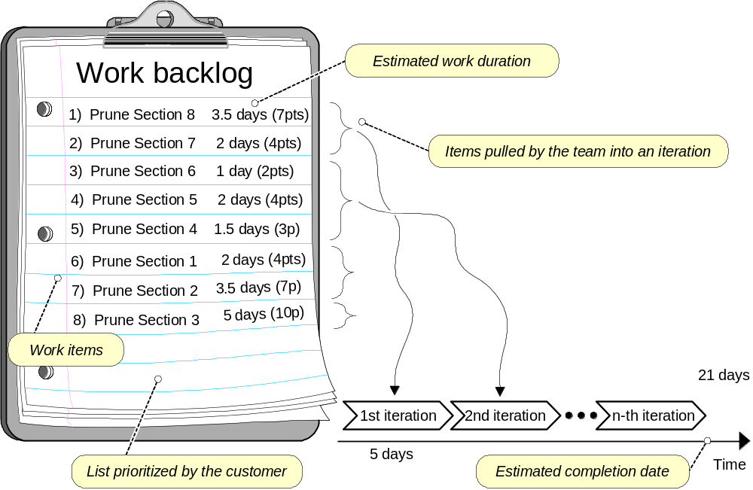
Agile Project Effort Estimation

Slide 52
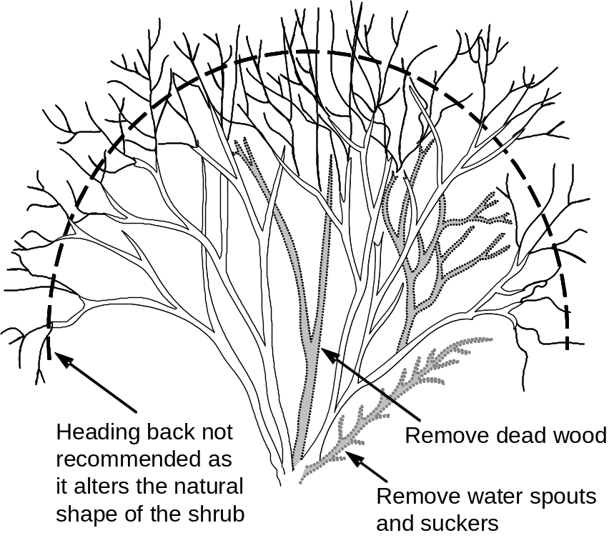
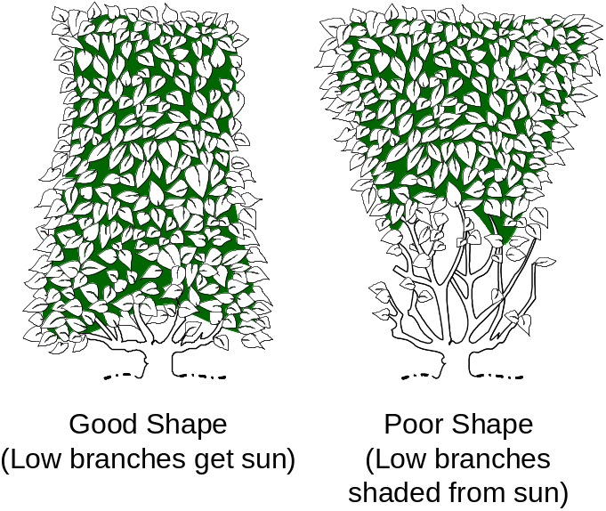
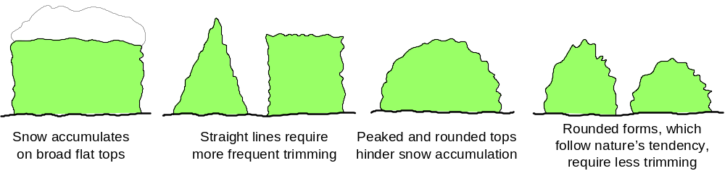
Measuring Quality of Work

Slide 53
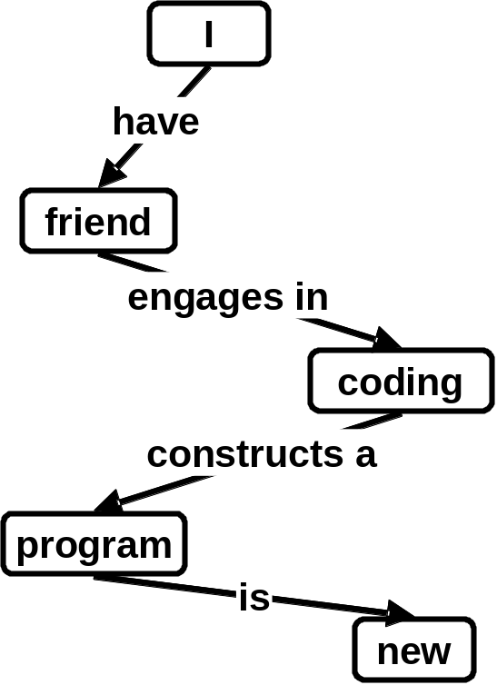
Concept Maps
Useful tool for problem domain description, knowledge, beliefs, feelings representation
Concepts: apperceived regularities in objects-events-ideas, designated by a label such as “green”, “high”, “acceleration”.
Proposition or sentence: basic unit of meaning or expression, which is an expression of the relation among concepts.
Sentence: “My friend is coding a new program”
Concept maps: concepts + propositions (sentences)
translated into propositions
Proposition | Concept | Relation | Concept
1. | I | have | friend
2. | friend | engages in | coding
3. | coding | constructs a | program
4. | program | is | new
Search the Web for Concept Maps

Slide 54
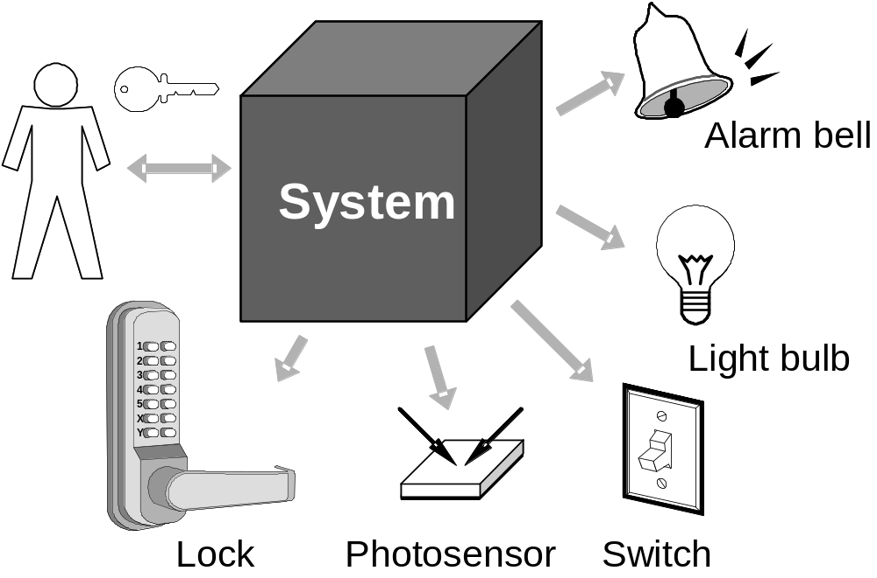
Case Study: Home Access Control
Objective: Design an electronic system for:
  Home access control
    Locks and lighting operation
  Intrusion detection and warning

Slide 55
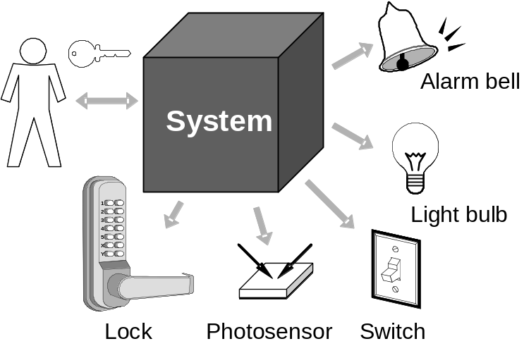
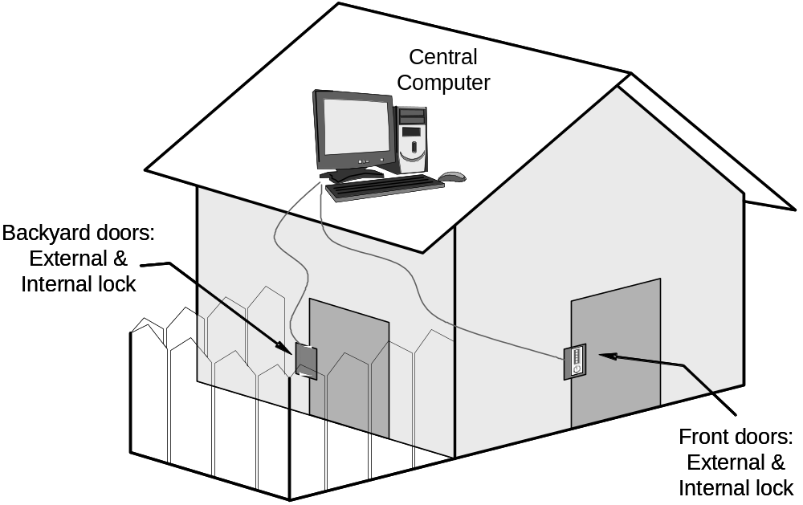
Case Study – More Details

Slide 56
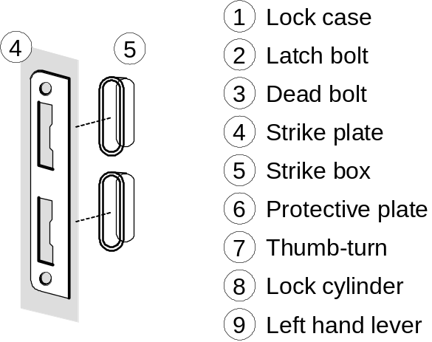
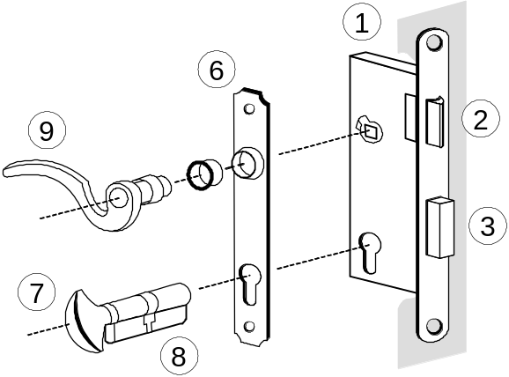
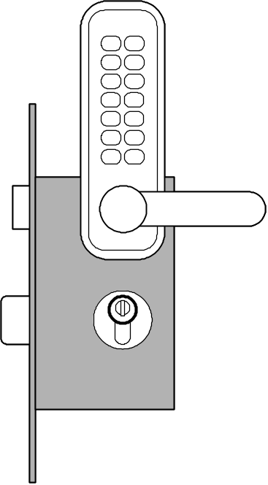
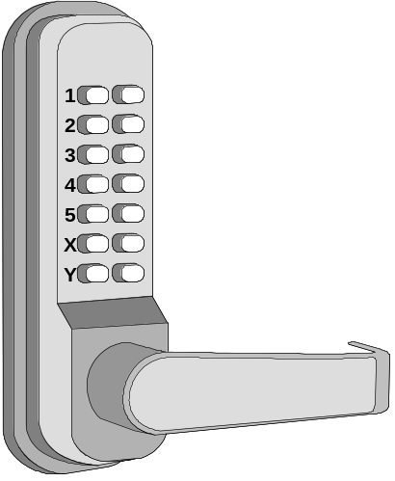
Know Your Problem
Mortise Lock Parts

Slide 57
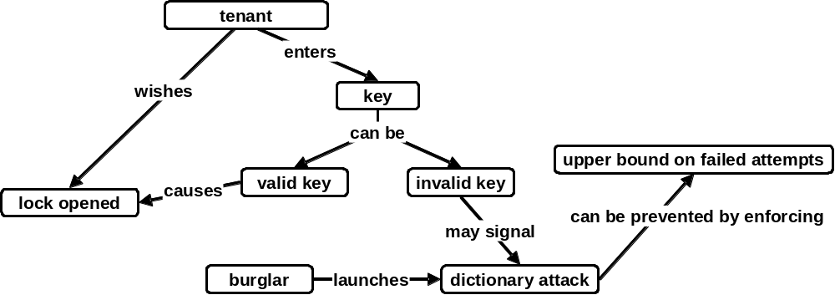
Concept Map for Home Access Control

Slide 58
States and Transition Rules
IF validKey AND holdOpenInterval THEN unlock
IF validKey THEN unlock
locked
unlocked
IF pushLockButton THEN lock
IF timeAfterUnlock ≥ max{ autoLockInterval, holdOpenInterval } THEN lock
… what seemed a simple problem, now is becoming complex

